Slide 1

RISK MANAGEMENT
GROUP: BREAKFAST CLUB

Slide 2
OUTLINE and OBJECTIVES
What is risk and risk management
The process of risk management and why is it important for project management
Understand what is risk and the importance of risk management
Understand the process of risk management and its usefulness

Slide 3
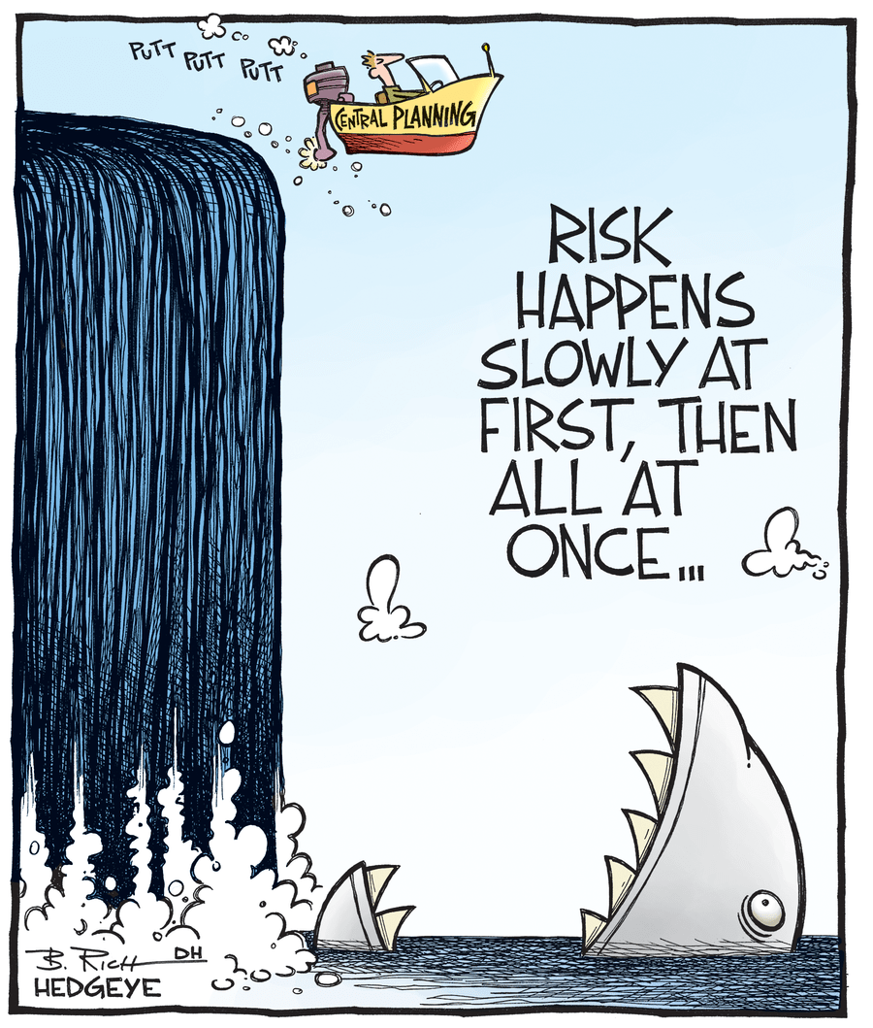
WHAT IS RISK?
Uncertain circumstances that if occurs can result in positive or negative outcomes on the project.

Slide 4
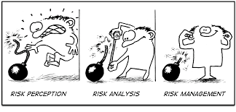
WHAT IS RISK MANAGEMENT?
An approach that explore and identify the probability of risks as well as mitigate the impact of risks towards the project’s objectives

Slide 5
WHY IS RISK MANAGEMENT IMPORTANT
1
2
3
Ensure successful completion of the project
Maximise positive opportunities while eliminating negative outcomes
Help stakeholders to set expectations regarding the project

Slide 6
RISK MANAGEMENT PROCESS
Risk identification
Qualitative risk analysis
Quantitative risk analysis
Risk response planning
Risk monitoring and control
1
2
3
4
5

Slide 7
RISK IDENTIFICATION
Developing risk checklists for potential risks and calculate the possibility that the risks might occur on a project
Risk checklists can be based on previous experiences or past projects

Slide 8
MAIN SOURCES OF RISK
1
Cost risk
Poor cost estimation -> increase costs
Scope risk
More requirements from clients -> Grows in complexity
Scheduling risk
Unexpected delays e.g. from natural disasters
Resource risk
Outsourcing issues
Technology risk
Software & hardware malfunctions
2
3
4
5

Slide 9
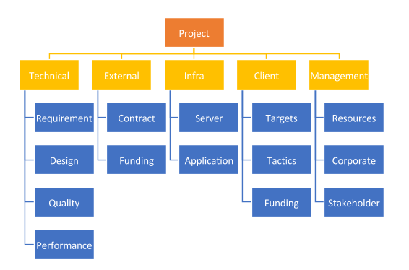
RISK BREAKDOWN STRUCTURE (RBS)
Hierarchical representation of risks that
Helps to structure the management process
Ensure coverage during the identification process

Slide 10
INFORMATION GATHERING METHODS
Brainstorming
Nominal group
Core team for risk identification
Each person allocated different area of risks and come up with a list of risks within that area
Delphi technique
Facilitator recruit experts to ask questions and identify common answers
Results share with expert for validation then share with the panel
Mind mapping

Slide 11
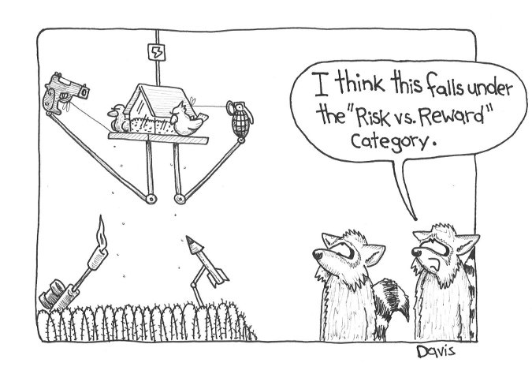
QUALITATIVE RISK ANALYSIS
Risk is prioritised based on the probability and the level of impact.

Slide 12
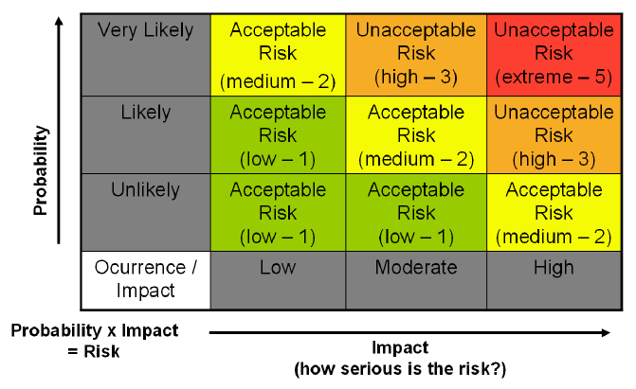
PROBABILITY & IMPACT RISK MATRIX
Common tool to categorise the risks as HIGH, MEDIUM or LOW base on the likelihood of occurance and its impact,
Useful for identifying which risks need immediate attention and which risks are insignificant

Slide 13
QUANTITATIVE RISK ANALYSIS
Numerical analysis of the probability and impact of each risks.
Normally done after the qualitative risk analysis but can be done simultaneously as well.

Slide 14
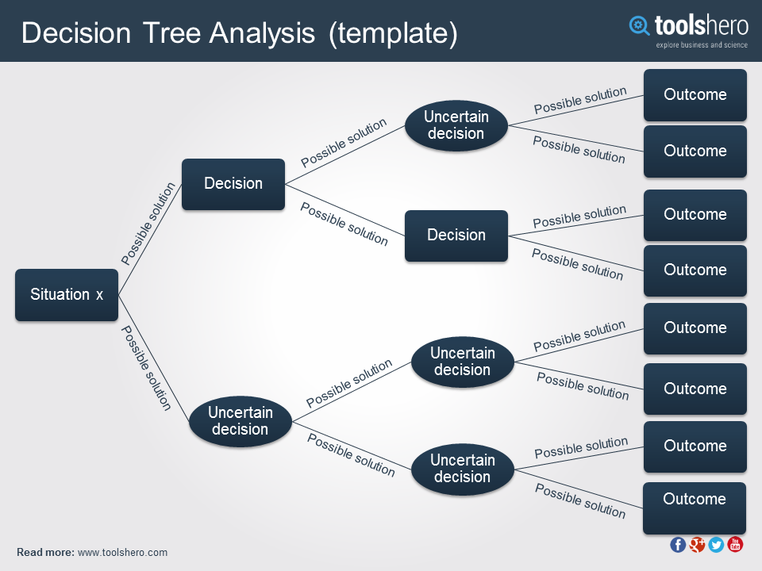
DECISION TREE ANALYSIS
Helps to select the best possible actions in situations with uncertain future outcomes.

Slide 15
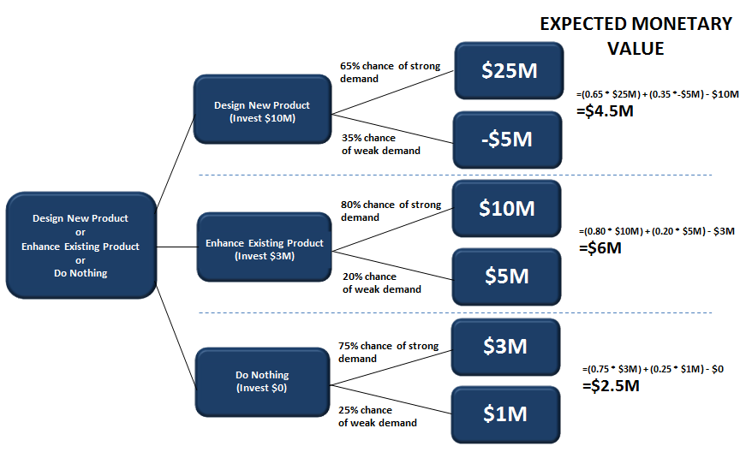
EXPECTED MONETARY VALUE (EMV)
Numerical concept that calculates the average results of the future outcomes including scenarios that may or may not happen.
Helps to calculate the amount needed to manage all the identified risks
Help to identify the choice that requires less money to manage the risks

Slide 16
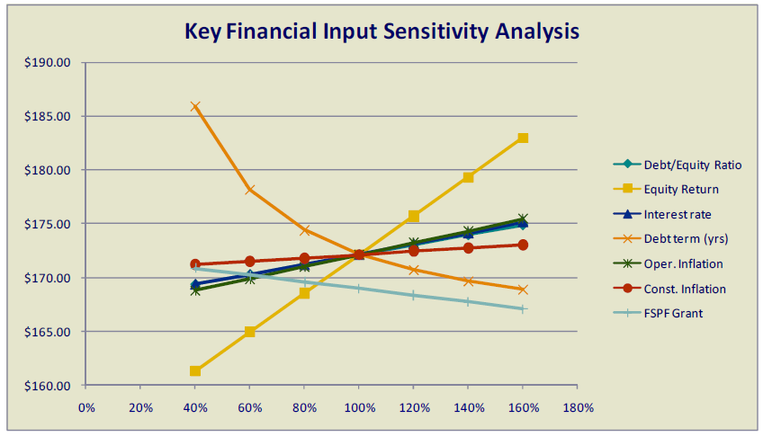
SENSITIVITY ANALYSIS
Shows the consequences of changing one or more variables on an outcome.
Normally created by Spreadsheet software such as Excel
Useful for predicting the outcome of a decision considering a range of variables.

Slide 17
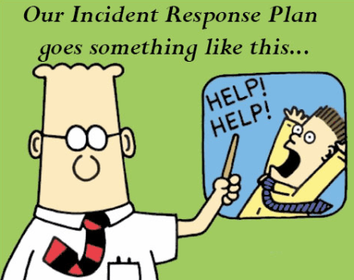
RISK RESPONSE PLANNING
Determining series of responses to both positive risks (opportunities) as well as negative risks.
Responses should be SMART
Specific, Measurable, Action orientated, Realistic and Time-bound
Need to prepare for contingency plan (if risks happen) and fallback plan (when contingency plans are not effective)

Slide 18
POSITIVE RISK RESPONSE
Exploit
Ensuring that the situation will happen and reap as much reward from it as possible
Share
Share the opportunity to other party who can enhance the situation to share the responsibility and ownership
Enhance
Strengthen the positive impacts attached to the situation
Accept
Take advantage of the opportunity but not actively pursuing it

Slide 19
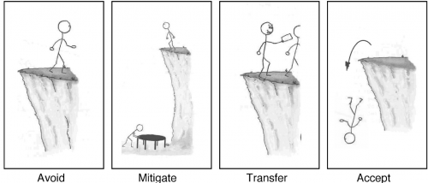
NEGATIVE RISK RESPONSE
Avoid
Change the project’s objectives, reduce the scope or modify the schedule to avoid the risk
Transfer
Transfer the risk to third party who are more equipped to manage the risk
Does not get rid of the risk
Mitigate
Reduce the impact of the risk on the project e.g. adopting less complex processes
Accept
Risk cannot be alleviated or eliminated
Need contingency plan regarding time, resource or money

Slide 20
RESIDUAL AND SECONDARY RISK
Secondary risk
Risks which are direct results of implementing risk responses
Residual risk
Risks that are expected to remain after the response planning has been taken
Often minor and seen as leftovers risks but evaluation is required still
Both risks need to be taken into account during the identification process and closely monitored to see whether contingency plan is needed

Slide 21
RISK CONTROL AND MONITORING
Process of executing the risk management cycle to ensure the effectiveness throughout the project.
This process can involve selecting different strategies, modifying the projects or implementing fall back plans.

Slide 22
TOOLS FOR RISK MONITORING
Risk audit
Need to be scheduled regularly to identify new risks
Risk reassessment
Evaluate the effectiveness of the risk response planning
Trend analysis
Monitoring overall performance of the project

